Slide 1

METR 150 Project 1
By: Jeremy Benik
Dr. Tan

Slide 2
Part 1 - Data used
The stations used for this study are KTPH in Tonopah, Nevada and KFHR in Friday Harbor, Washington
Data from 2021 was used in this study
The variables explored are temperature, dew point temperature, and wind Speeds at both locations

Slide 3
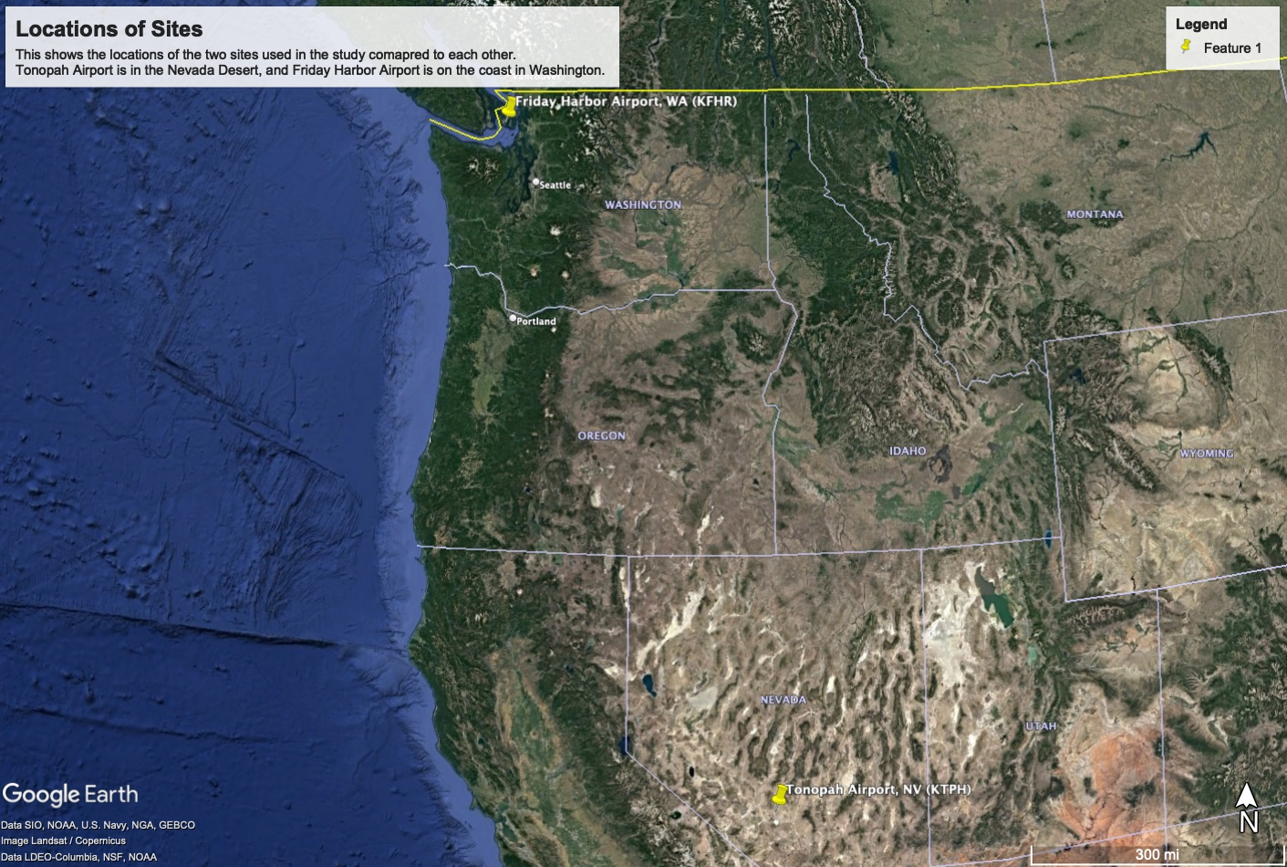
Locations of sites
While these two sites are on the same coast, they differ in their climate
Tonopah, NV is in the middle of the Nevada desert, and is hot and dry, especially in the summertime
In the winter, it can get cold and receive snowfall
Friday Harbor, WA is on the Pacific Coast which means it will receive more rain, and overall cooler temperatures more often than in Tonopah, NV

Slide 4
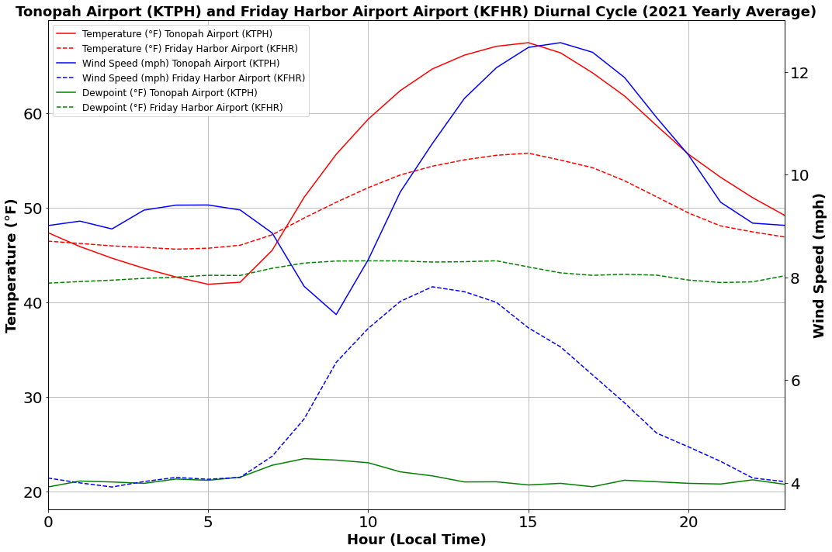
Part 1
Diurnal cycle of temperature, dewpoint, and wind speed for 2021 at Tonopah Airport, and Friday Harbor Airport
Temperature at Tonopah Airport is much warmer around 15:00 than at Friday Harbor Airport
Tonopah airport is much drier than Friday Harbor Airport
Dewpoint temperature at Tonopah Airport is in the mid 20’s
Dewpoint temperature at Friday Harbor Airport is in the mid 40’s
It is also much windier in Tonopah (12+ mph) compared to Friday Harbor ( < 8 mph)

Slide 5
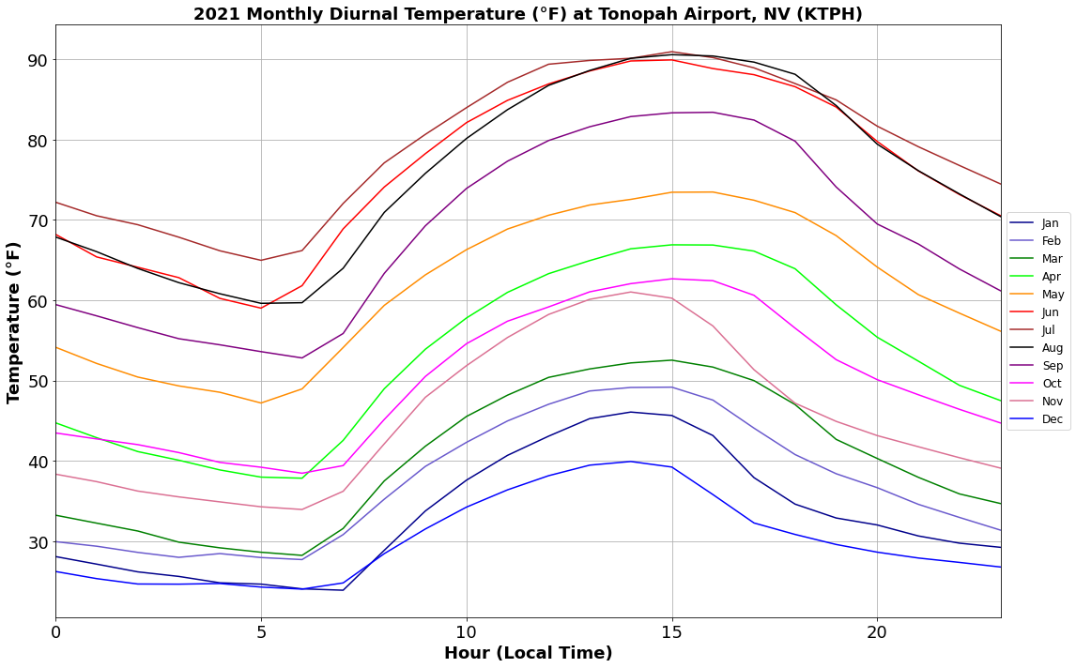
Part 1
Monthly diurnal cycle of temperature for Tonopah Airport (KTPH), NV
In this chart, there is a clear distinction between the summer months and the winter months
Temperatures in the summer reached around 90 degrees Fahrenheit whereas winter months had highs in the lower 40’s

Slide 6
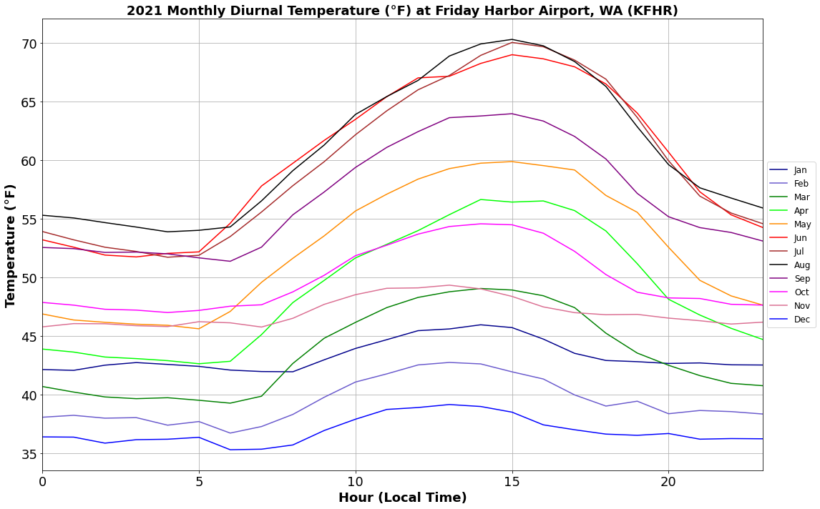
Part 1
Monthly diurnal cycle of temperature for Friday Harbor Airport (KFHR), WA
In this chart, there is a clear distinction between the summer months and the winter months
Temperatures in the summer reached around 70 degrees Fahrenheit whereas winter months had highs in the upper 30’s
High temperatures at Friday Harbor Airport are much cooler than at Tonopah
The timing of the high temperatures occur at roughly the same time at both stations (15:00)

Slide 7
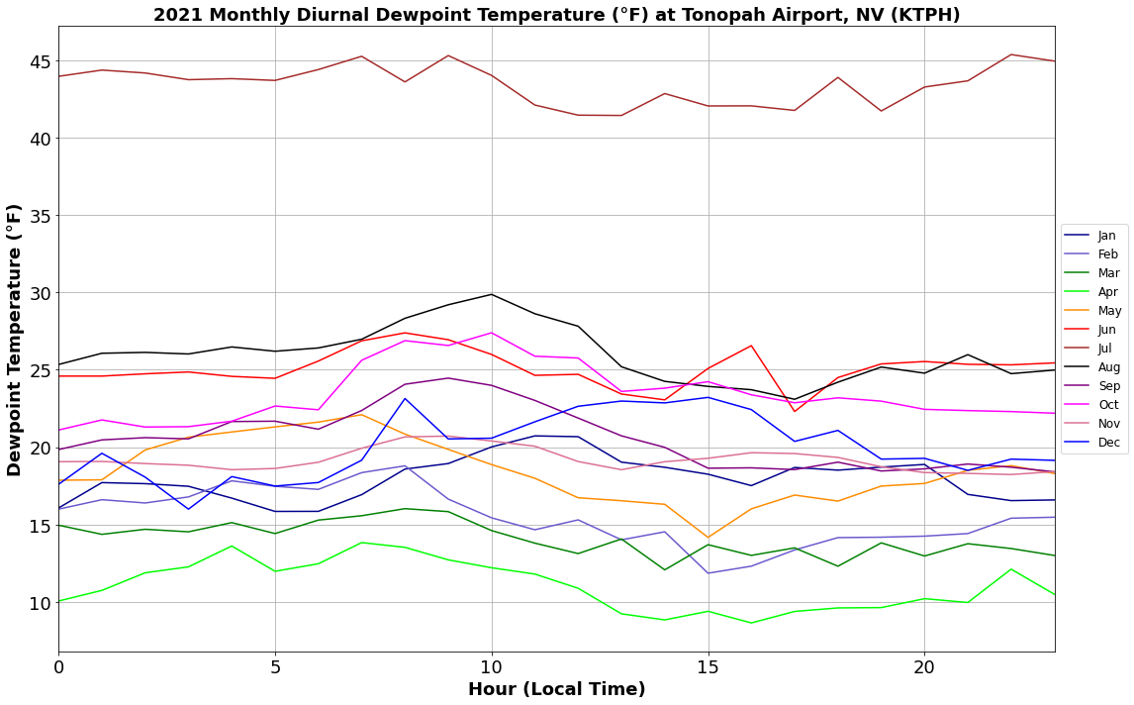
Part 1
Monthly diurnal cycle of dewpoint temperature for Tonopah Airport (KTPH), NV
For most of the months, they are within 20 degrees Fahrenheit of each other
One month that sticks out is July with dewpoint temperatures in the mid to low 40’s
One possible explanation of this is the Monsoon season
As the land heats up, humid air from the Pacific Ocean moves inland towards Arizona and Nevada (lasvegasnevada.gov)

Slide 8
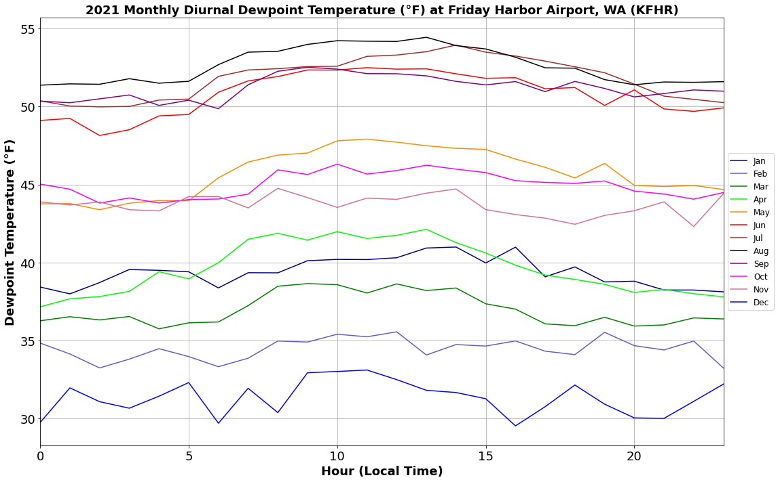
Part 1
Monthly diurnal cycle of dewpoint temperature for Friday Harbor Airport (KFHR), WA
Like with the temperature plots, there is a clear distinction between seasons with summer dewpoint temperatures in the lower to mid 50’s and winter dewpoints are in the lower 30’s
Unlike with Tonopah Airport, there is not one month that sticks out among the rest
Comparing this plot with the temperatures reveals the air is much more humid at this location than in Tonopah, NV

Slide 9
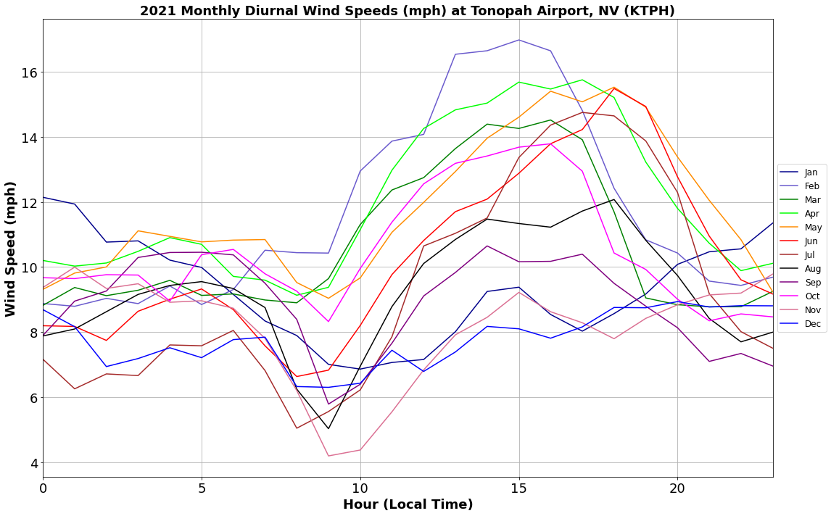
Part 1
Monthly diurnal cycle of Wind Speeds for Tonopah Airport (KTPH), NV
Wind speeds tend to reach a max between 15:00 and 20:00 for most months
Highest wind speeds occur in the spring and winter months whereas summer months don’t experience as much winds

Slide 10
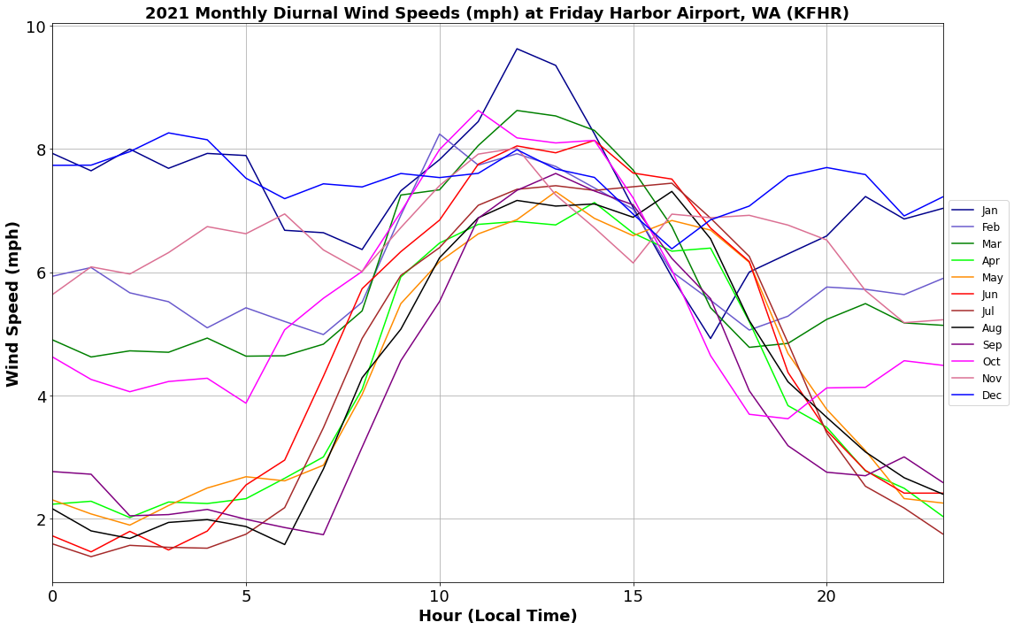
Part 1
Monthly diurnal cycle of Wind Speeds for Friday Harbor Airport (KFHR), WA
Wind speeds tend to reach a max between 10:00 and 15:00 for most months which differs from Tonopah (reaching maximum wind speeds around 15:00 – 20:00)
Highest wind speeds occur in the spring and winter months
Wind speeds are not as strong as in Tonopah
Strongest wind speeds in this chart reach ~9 mph whereas Tonopah was closer to 17 mph

Slide 11
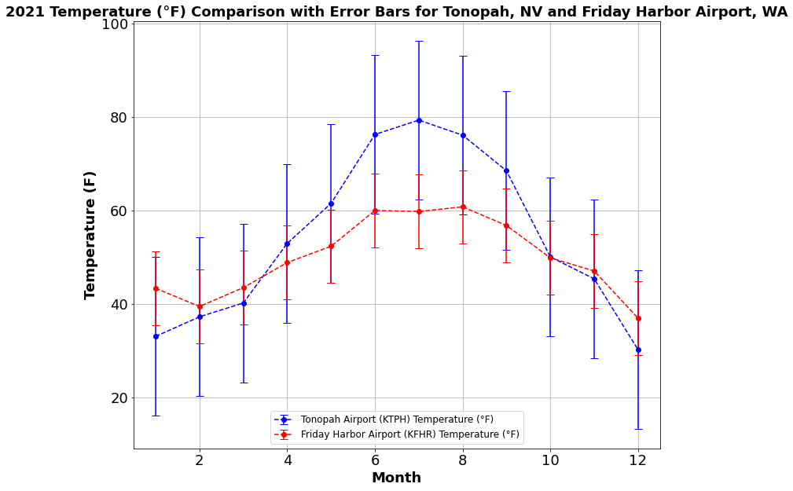

Part 1
Site comparison of Temperature for 2021 with error bars
In the summer months (6-9) Tonopah is much warmer than Friday Harbor with temperatures reaching close to 100 degrees Fahrenheit
Winter months (11-2) are cooler in Tonopah than in Friday Harbor with temperatures in Tonopah reaching below 20 degrees Fahrenheit whereas Friday Harbor is in the upper 30s

Slide 12
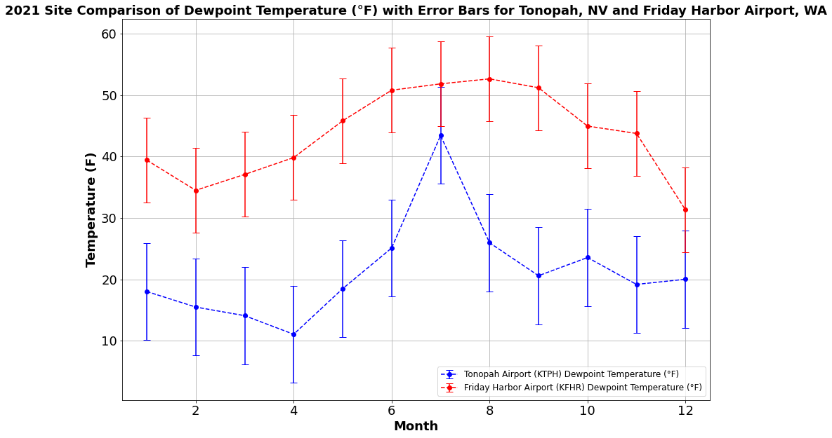
Part 1
Site comparison of dewpoint temperature for 2021 with error bars
Friday Harbor has much higher dewpoint temperatures than in Tonopah
Since Tonopah is in a desert, and Friday Harbor is on the coast, these values are to be expected since there is a body of water next to Friday Harbor, whereas Tonopah is in the middle of a desert
As seen before, July in Tonopah had a higher dewpoint temperature than the other months, and this can be seen in this chart

Slide 13
Part 2

Slide 14
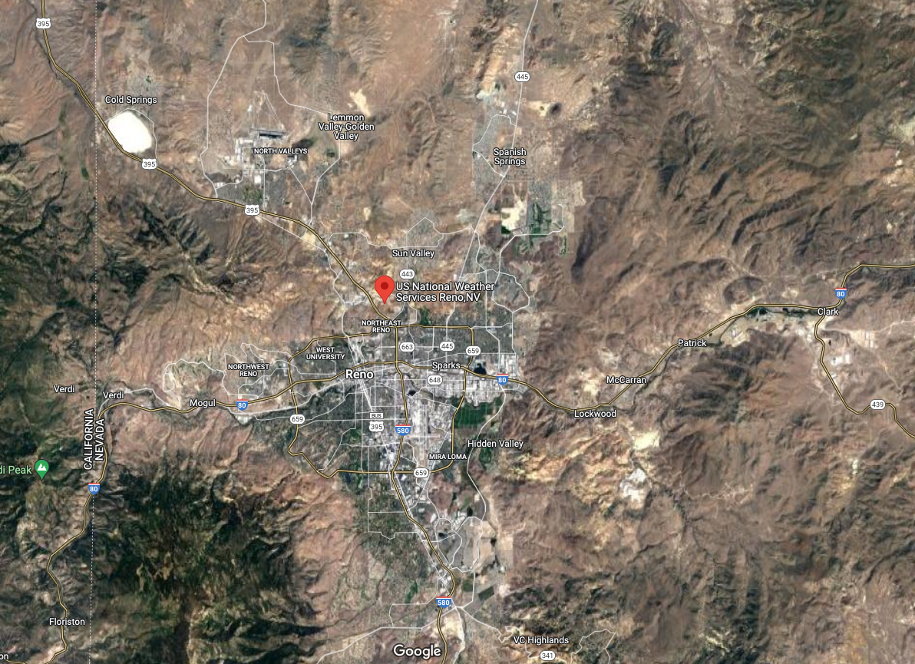
Part 2- Sounding data
The location used for this part was 72489 REV, Reno, NV
This site is at an altitude around 5000 ft ASL
This site located in northern Nevada

Slide 15
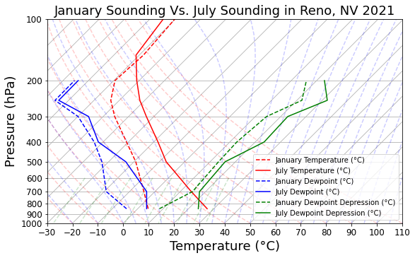
Part 2
Sounding for Reno, Nevada
The times compared in this sounding are January 2021 and July 2021
Temperatures and dewpoint temperatures in July are warmer than in January
Soundings indicate stable surface conditions which is surprising since January typically sees a lot of inversions
With this station being at such a high altitude (~5000 ft ASL), surface pressure is around 850 hPa

Slide 16

Part 3

Slide 17
Part 3 a–Decadal Mean temperature (1950-1959)

Slide 18
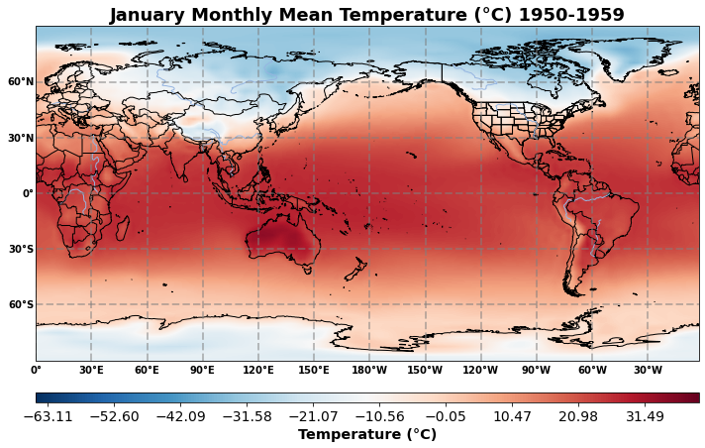
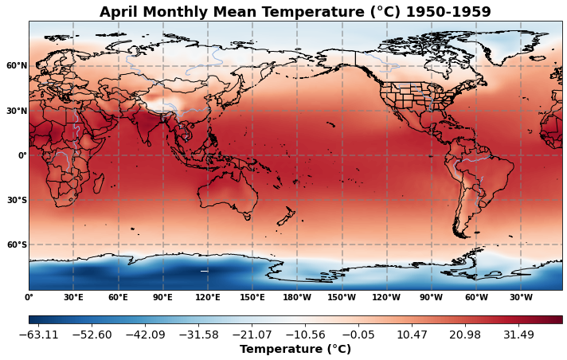
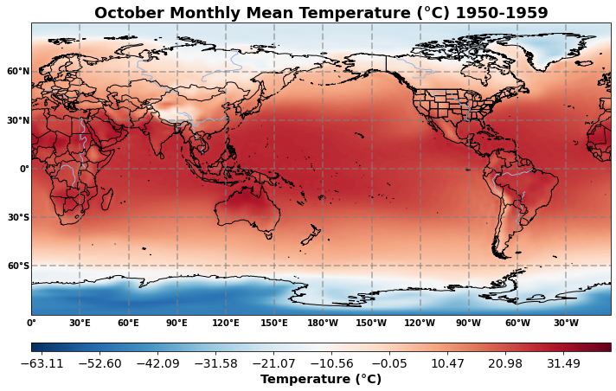
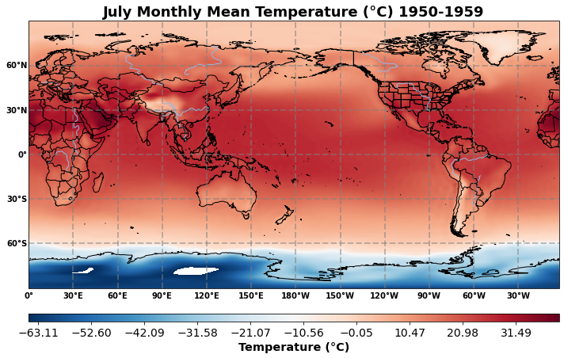

Slide 19
Part 3 a
As seen in the previous slide, the northern hemisphere starts out much cooler than the southern hemisphere, but as the seasons go on, this starts to flip (southern hemisphere gets colder than the northern hemisphere)
As October comes around, then the northern hemisphere starts to cool off again

Slide 20
Part 3 b Temperature anomaly for January and July of 1st and 10th year from 1950-1959

Slide 21
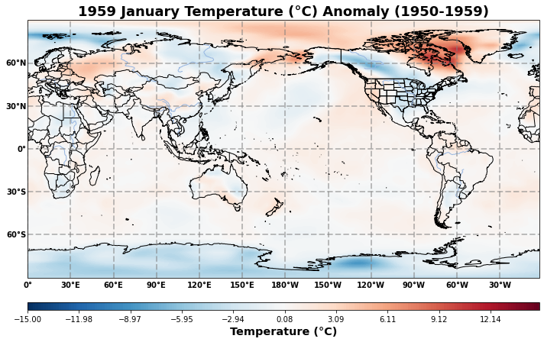
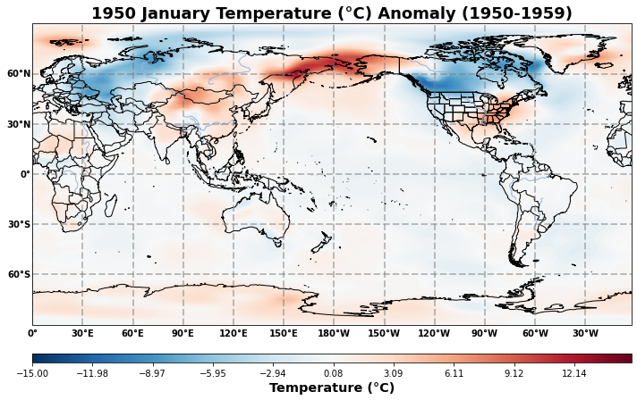
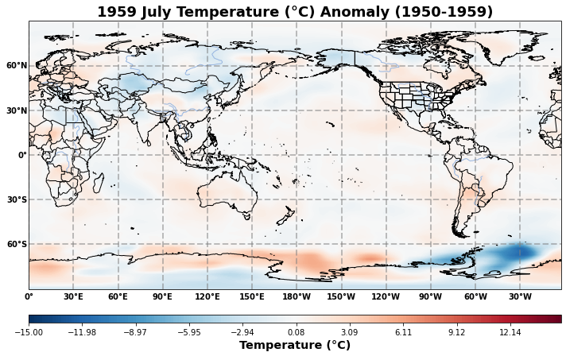
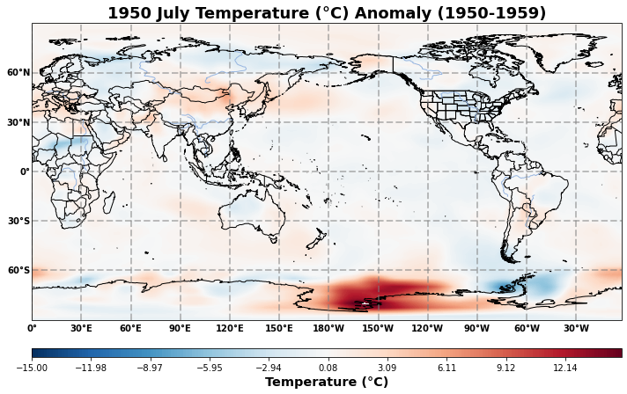

Slide 22
Part 3 B
Overall, there is not too much variation in the temperature anomalies
Some areas saw an increase in temperature (namely Antarctica in July 1950 and the Bering straight in 1950)
Other areas were noticeably cooler such as North America in 1950 and 1959

Slide 23
Part 3 c Warmest and coldest temperature anomalies in 1950-1959

Slide 24
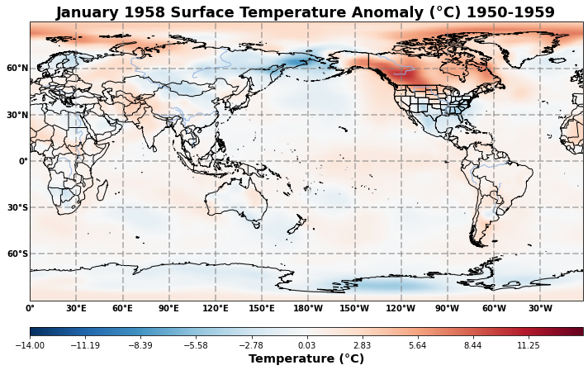
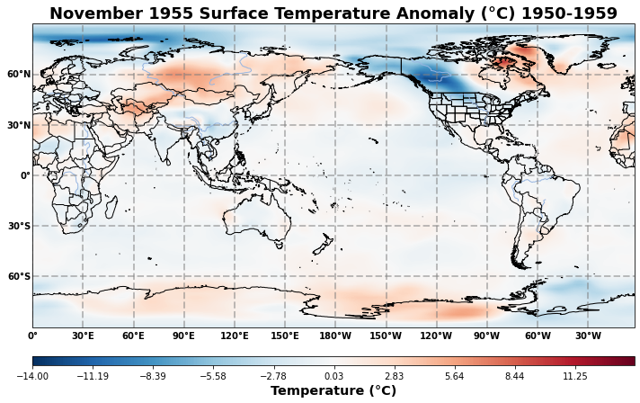
Warmest
Coldest

Slide 25
Part 3 c
The warmest temperature anomaly occurred in January 1958
Most of the globe is warmer than usual, especially in North America
The coldest temperature anomaly occurred in November 1955
While there are some spots that are warmer than warmer than usual, most the globe is cooler than usual

Slide 26
Part 3 D Mean Temperature at 850 hpa and 100 hpa for 1991-2020

Slide 27
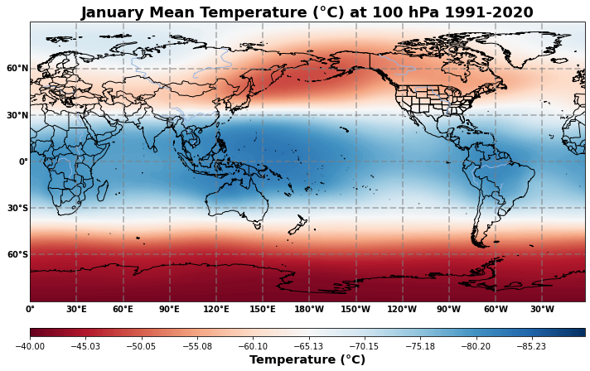
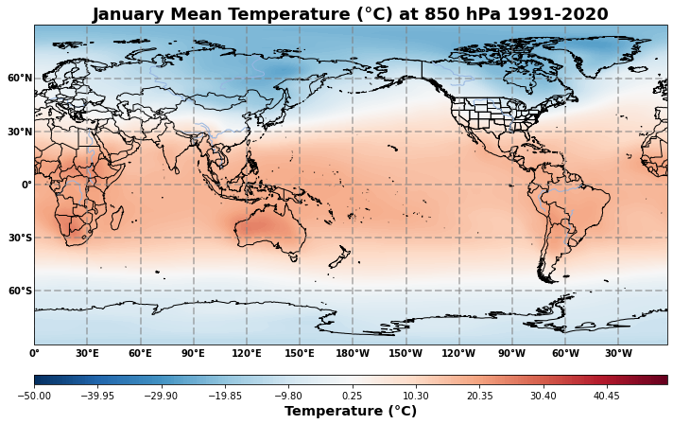
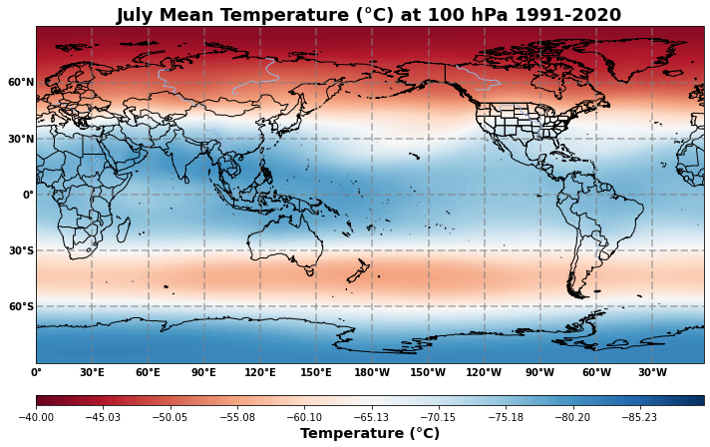
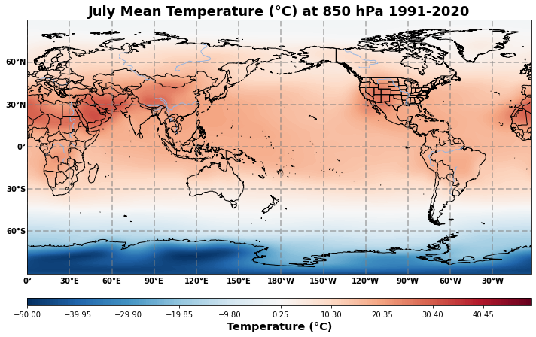

Slide 28
Part 3 d
These charts are the mean temperature at 850 hPa and 100hPa for January and July 1991-2020
These graphs are another good depiction of the seasonal change in temperatures as the southern part of the world is colder in July at both 100 hPa and 850 hPa, and warmer in January at both levels

Slide 29
Part 3 D 850 hpa and 100hpa Temperature Anomaly for warmest and coldest months between 1991-2020

Slide 30
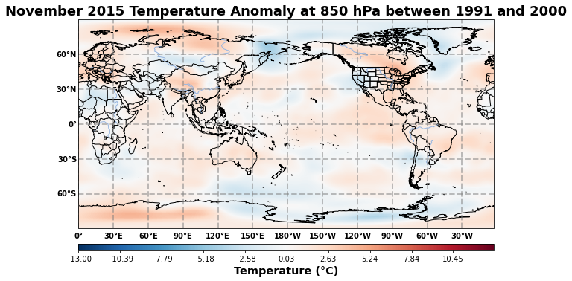
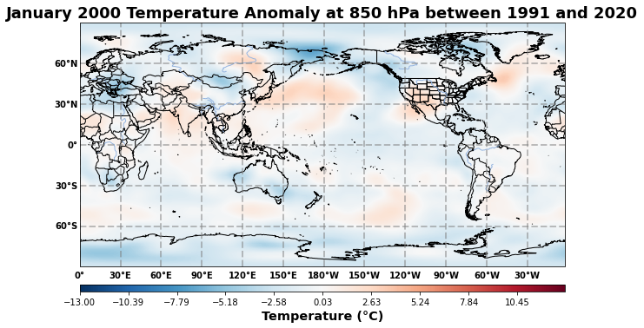
850 hPa
Warmest
Coldest

Slide 31
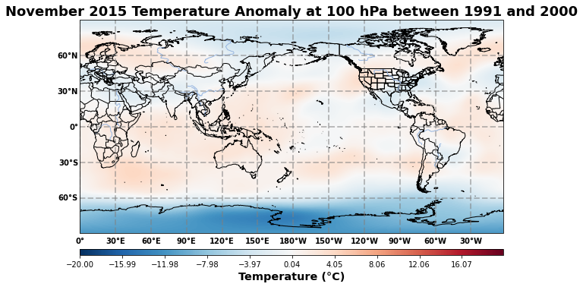
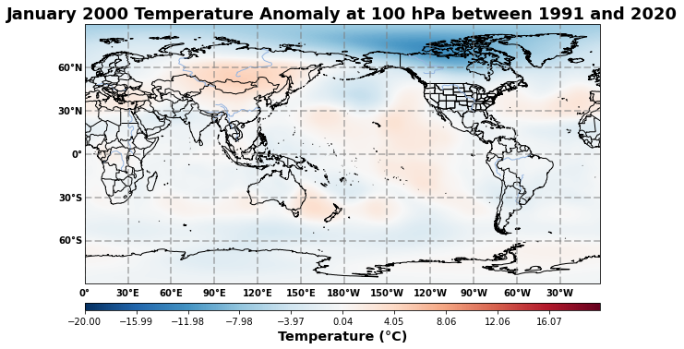
100 hPa
Warmest
Coldest

Slide 32
Part 3 d
These charts are the warmest and coldest temperature anomalies between 1991 and 2020 at 850 hPa and 100 hPa
November 2015 had the highest temperature anomaly between 1991 and 2020, and January 2000 had the coldest temperature anomaly
In November 2015, the effects of the warmer month can be seen in the oceans and in North America where temperatures were warmer than usual
January 2000 had colder ocean temperatures and there is quite the anomaly over northern Canada and northern Greenland

Slide 33
Link to codes
If anyone would like to check out my codes, I have uploaded them all to my github for documentation
Link: https://github.com/Jeremy-Benik/MET150/tree/main/Projects/Project1
Citation:
Home, https://www.lasvegasnevada.gov/News/Blog/Detail/monsoon-season.

Slide 34
Thank you

